Slide 1

FOOD PRE ORDERING APP
- CapCafe

Slide 2
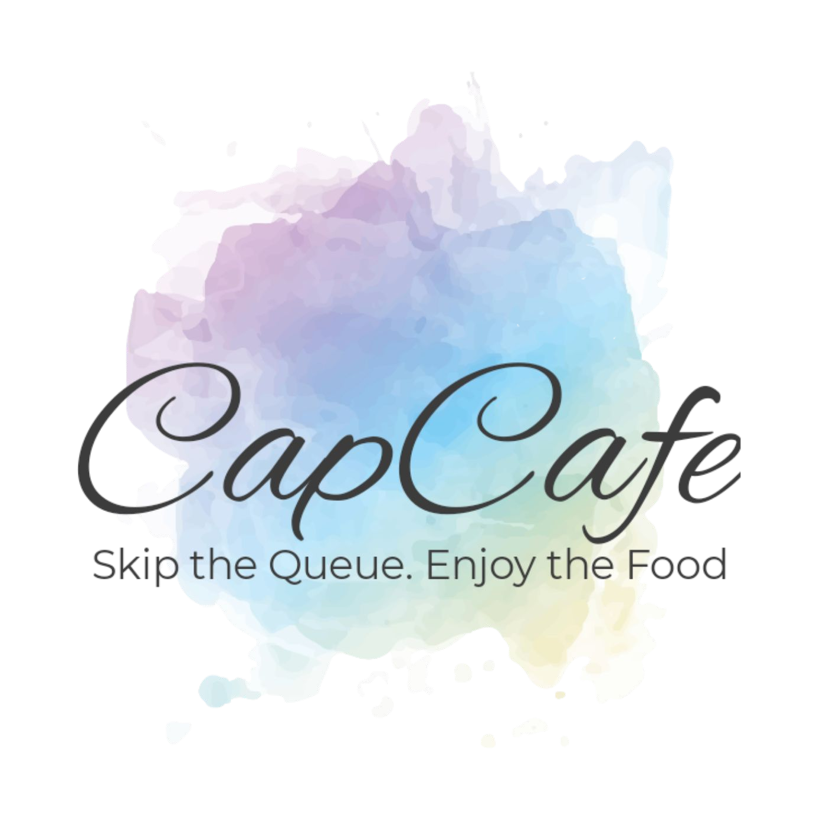

Abstract

Slide 3




Goals
Customer Satisfaction
Security
User Friendly
Flexibility

Slide 4
Micro-Service Technology Stack
Cloud Technology Stack
Presentation layer:
Angular (v 6)
Presentation layer:
Angular (v 6)
Spring Boot (v 2.2.1) , Java (v 8)
Amazon Simple Storage Service
Storage Service:
Business layer:
Cross-cutting concern: Spring Security
Spring Web, Spring Framework
Amazon Elastic Compute Cloud
Compute Service:
Data layer:
Spring Data JPA
Database Service: AWS RDS - My SQL
My SQL (v 5.5)

Slide 5
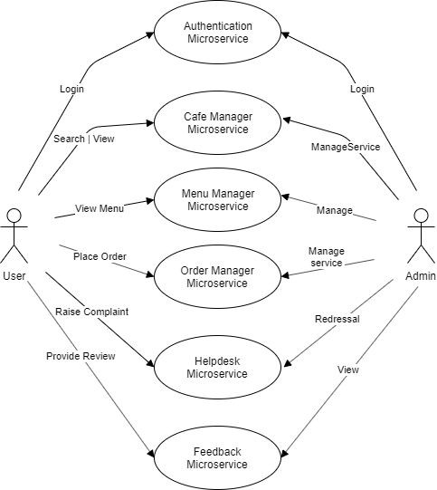
Use-Case Diagram

Slide 6

Project Architecture
Login/signup
DB
Eureka Server
Cafe Details
DB
Cafe - front microservice
Cafe Menu
DB
Order
DB
Helpdesk
DB
Review
DB

Slide 7
Micro-Services
1. Login/Signup
Sign-up
Login
Forgot password
Reset password
Proﬁle
View all
2. Cafe Details
Add Cafe
Remove Cafe
Fetch cafe by location
Fetch all cafe
Update cafe
Add menu to cafe
Cafe Menu
Add Menu
View Menu
Fetch menu item by name
Delete menu
Update menu

Slide 8
Micro-Services
4. Orders
Add item to cart
Place order
View conﬁrmation message
View previous orders
View all orders
5. Help-desk
View tickets
Raise ticket
Response a ticket
Mark ticket as resolved
Review
View Cafe/ Item Review
Add Cafe/ Item Review
Add Cafe/Item Rating
View Cafe/Item Average Rating

Slide 9
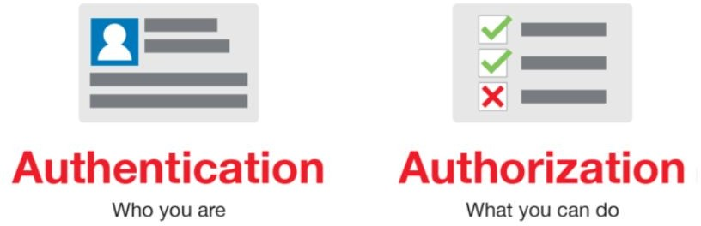
Security = Authentication + Authorization

Slide 10

Link S3 and deploy microservice
Install JDK 8
Set-up Linux - 64 bit OS
Set-up Amazon Elastic Compute Cloud
Deploy jar files in AWS S3
Set-up Simple Storage Service
Connect with microservices
Set-up Relational Database service

Slide 11


























































Questions ?

